Slide 1

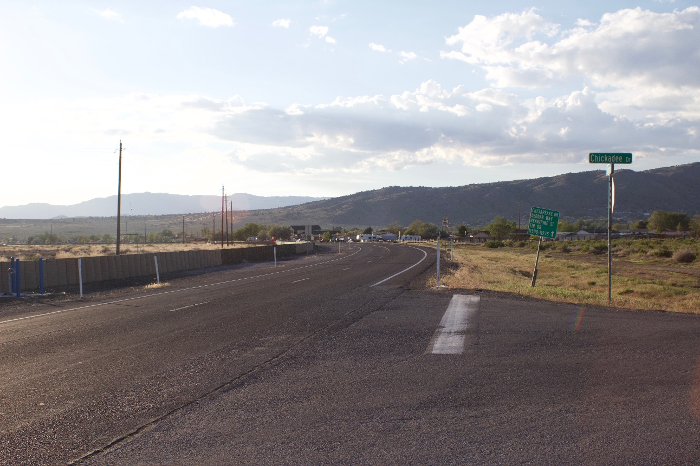





Public Hearing
Lemmon Drive Traffic Improvements and Resiliency Project
Presentation will begin at 6:00pm
February 19, 2026

Slide 2









Agenda
Welcome and Opening Remarks
Study Area
Project Purpose and Need
  Preferred Alternative (Build Alternative)
Summary of Environmental Assessment
Next Steps and Schedule
Providing Feedback
Notes:
Add some graphics

Slide 3
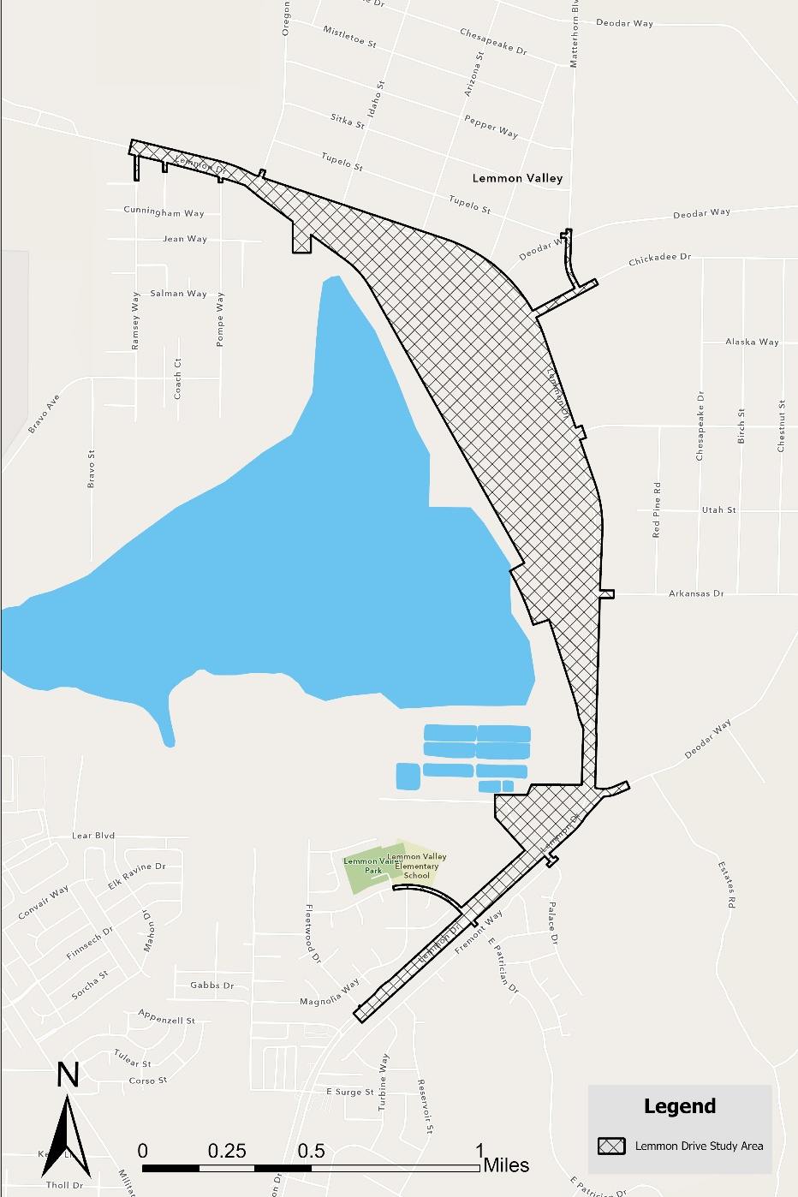
NEPA Study Area
Lemmon Drive
Chickadee Drive
Lemmon Drive from Fleetwood Drive to Ramsey Way
Swan Lake
Pedestrian improvements along Patrician Drive to Lemmon Valley Elementary
Lemmon Drive

Slide 4
What is NEPA?
NEPA is the National Environmental Policy Act (1969), requiring federal agencies to assess the environmental effects of proposed actions before making decisions
Using the NEPA process, agencies evaluate the environmental, social, and economic effects of proposed actions. Agencies also provide opportunities for public involvement through the process
In compliance with NEPA, RTC and NDOT prepared an Environmental Assessment (EA) to evaluate and document the potential impacts of the Lemmon Drive Traffic Improvements and Resiliency Project
$29 million in Federal funds are being used for the project
Federal land will be granted for a right of use of the new Lemmon Drive right-of-way

Slide 5
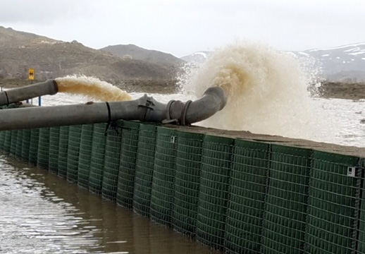
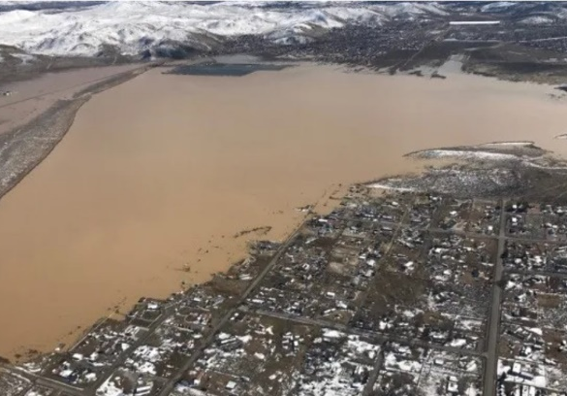
Why is the Project Needed?
In 2017, Lemmon Drive was overtopped by floodwaters, resulting in emergency closures and an extensive mitigation response which disrupted the community’s access, highlighting the need for a more resilient roadway.
Since 2017, Washoe County continues to expend significant financial resources on monitoring and controlling flooding from impacting private parcels and existing Lemmon Drive which is not a long-term sustainable solution.
In addition, multimodal enhancements were identified as a community need in the RTC’s North Valleys Regional Transportation Study.

Slide 6
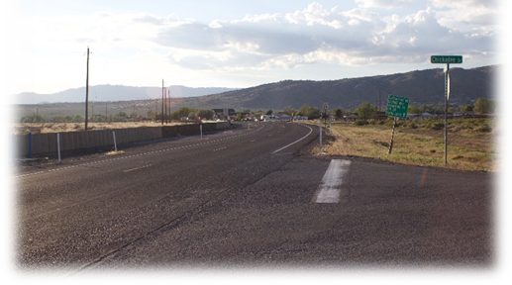
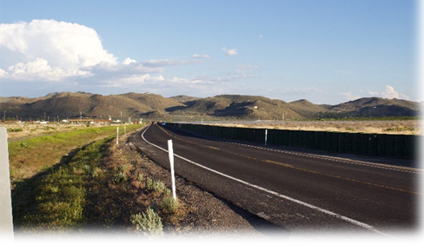
What is the Purpose of the Project?
Provide a safe and reliable regional road with at least one dry lane in each direction of travel during major flood events, including those that occur more frequently than a 100 year-flood. (Determined by FEMA Base Flood Elevation)
  100-year flood is a 1% yearly chance of roadway being under water
Provide safe access for all multimodal users with enhanced shared use path opportunities and safer pedestrian crossings
Reconstruct and upgrade Lemmon Drive to meet current design standards, 2050 RTP regional needs and address any deficiencies or safety concerns in the existing roadway alignment
Reduce maintenance costs and burdens on Washoe County and City of Reno during flooding events

Slide 7

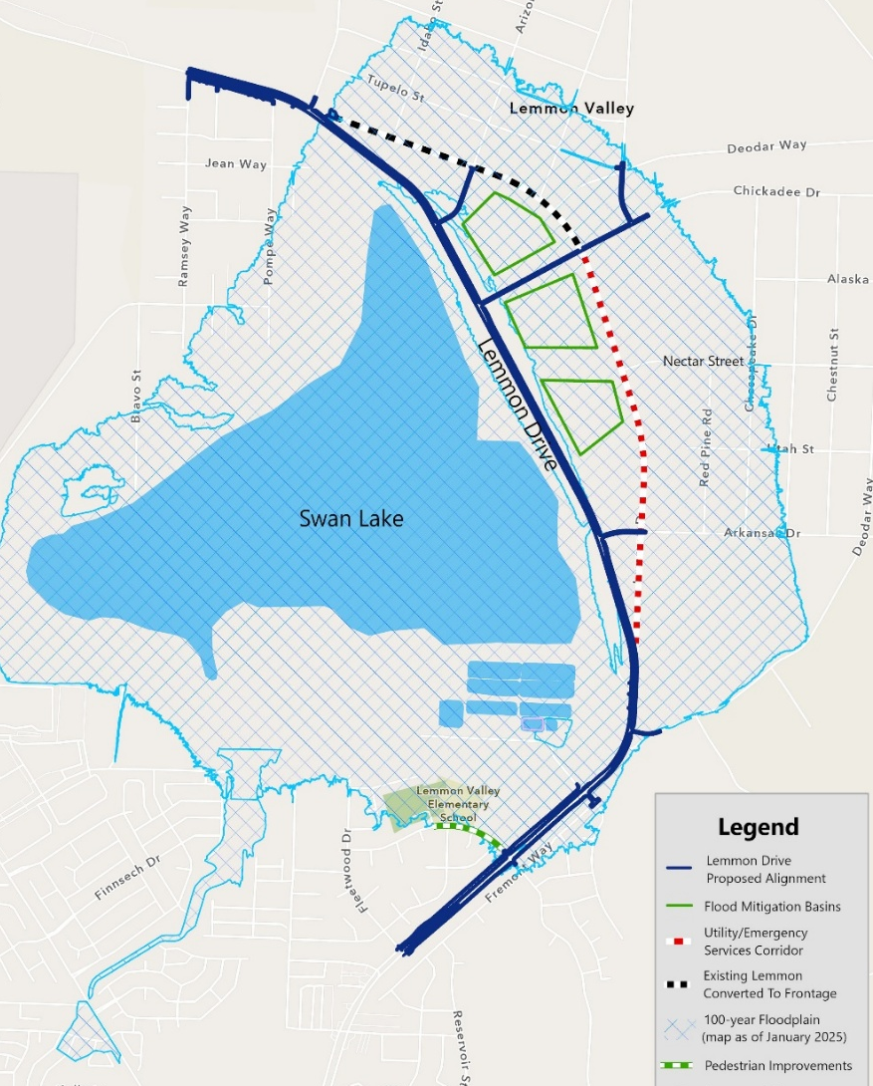
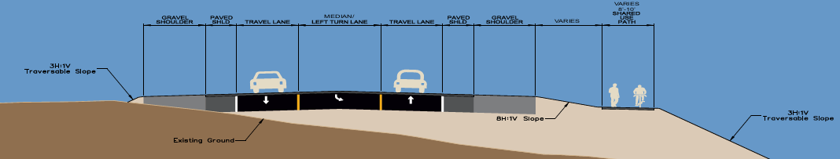
Preferred Alternative (Build Alternative)
Connections at Arkansas, Chickadee, and Arizona
Frontage road from east of Oregon to Chickadee
1.3 cubic yard out for every cubic yard in floodplain mitigation
Maintain existing speed limits
  35 mph south of Deodar
  45 mph north of Deodar
Six-foot paved shoulder plus gravel shoulder between travel lanes and roadway slope.
No change to emergency evacuation constraints

Slide 8
NEPA – Summary of
Environmental Assessment (EA)
Resources with
Little to No Impacts
Land Use and
Socioeconomics
Partial property acquisitions that would not result in any displacements
Construction expected to take 18-24 months consisting of two summer seasons
Intermittent lane closures and slower travel time during construction
  Cultural Resources
  Hazardous Materials
  PFAS
  Air Quality
  Traffic Noise
  Section 4(f) & 6(f)

Slide 9
NEPA – Summary of
Environmental Assessment (EA)
Floodplains and Water Resources
  Impacts to floodplains would result from widening the existing berm for the relocated Lemmon Drive
  Washoe County ordinances require volumetric mitigation within the floodplain at a ratio of 1.3 cubic yard of excavation for every 1 cubic yard of fill in the floodplain
  Considering the volumetric mitigation, no impacts to the regulated floodplains are expected
  Water quality and surface water will be minimally impacted due to the use of gutters, drains, and culverts to manage runoff

Slide 10
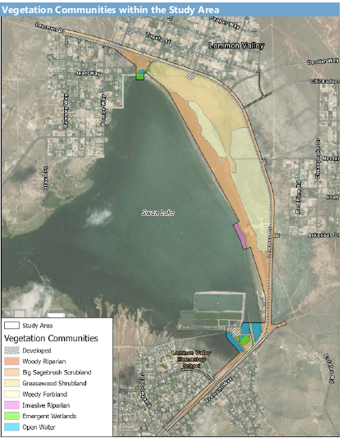
NEPA – Summary of
Environmental Assessment (EA)
Vegetation Communities Within the Study Area
Biological
Resources
Vegetation communities in the study area provide a variety of habitat for nesting birds
Swan Lake is a designated Important Bird Area (IBA) but the study area does not overlap the IBA boundaries
Pre-construction nesting surveys will be conducted and construction minimized during nesting season

Slide 11
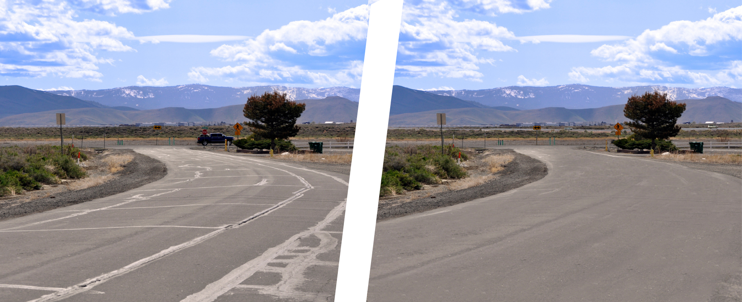
NEPA – Summary of
Environmental Assessment (EA)
Visual Resources
Visual quality and resources impacts for the Preferred Alternative is negligible
Impacts to visual resources will be mitigated through landscaping and aesthetic enhancements
Before
After

Slide 12
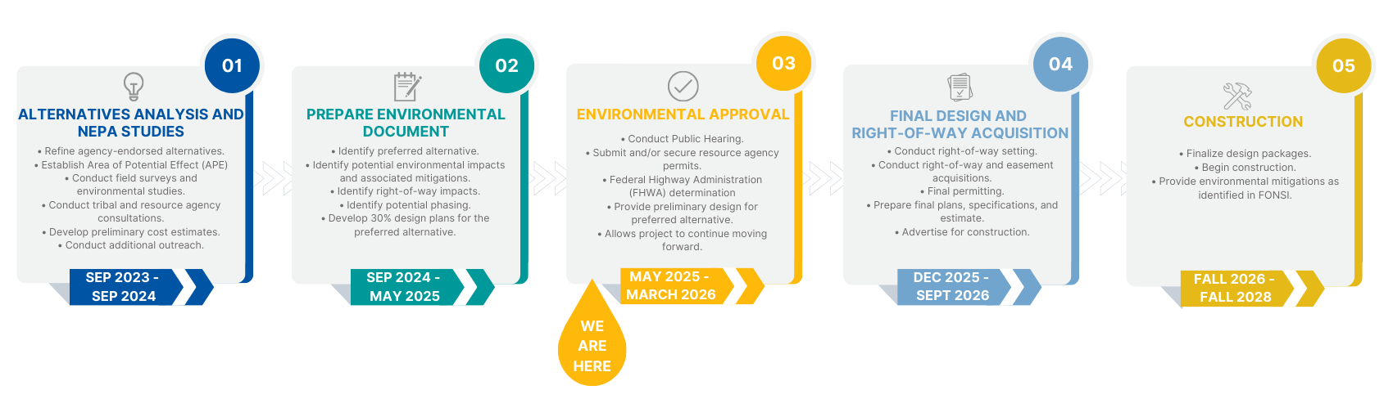
Project Schedule
Next Steps: Environmental Approval and Final Design and Construction

Slide 13
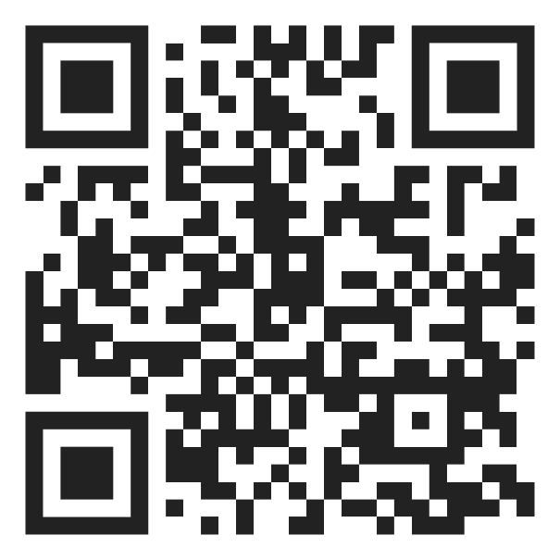
How Do I Provide Comments?
Scan QR code below to go to the meeting website
Fill out a comment form included in your handout packet and place it in the comment box or provide verbal comments to the court reporter
Submit your comment form by mail
  Bryan Byrne, PE, RTC Project Manager
  1105 Terminal Way, Reno, NV 89501
Send an email to bbyrne@rtcwashoe.com
Comments will be accepted up until 5:00 p.m. on March 9, 2026
Notes:
Combine 13 into 14.

Slide 14
Questions and Comments
Please state your first and last name prior to your question or statement
You will have one opportunity of up to three-minutes to deliver your question or statement
We have a countdown timer positioned at the front of the room for your reference
A court reporter will record the presentation and the Q&A period and is available to take individual comments
*NOTICE: The information you provide becomes a public record subject to disclosure (NRS 239.0107)

Slide 15

THANK YOU
Bryan Byrne, PE
Project Manager
Regional Transportation Commission of Washoe County
bbyrne@rtcwashoe.com
rtcwashoe.com
Your RTC. Our Community.

